Slide 1

Web Development
Lecture 04
Mr. Niaz Mir Khan
Lecturer in Computer Science
__________________________________________________
Department of Computer Science
Govt: Degree College Jamrud, District Khyber

Slide 2
Text Box
For text box, type=text in <input > tag.
  Text field is one line of text in input
<input type=text Name=“sname”>
<Input type=text Name=“address” Value=“Default Text” >
<input type=text Name=“age” size=“4” maxlength=“3” >

Slide 3
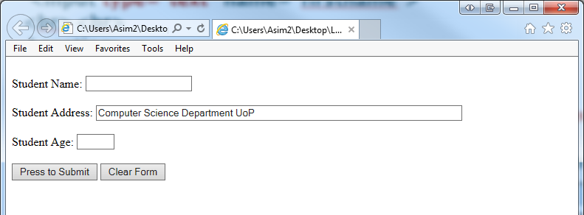
Example
<form>
Student Name:
<input type=text Name="sname" >
<BR><BR>
Student Address:
<Input type=text Name="address" value= "Computer Science Department UOP" size="80" >
<BR><BR>
Student Age:
<input type=text Name="age" size="4" maxlength="2">
<BR><BR>
<input type="submit" value="Press to Submit">
<input type="Reset" value="Clear Form">
</form>

Slide 4
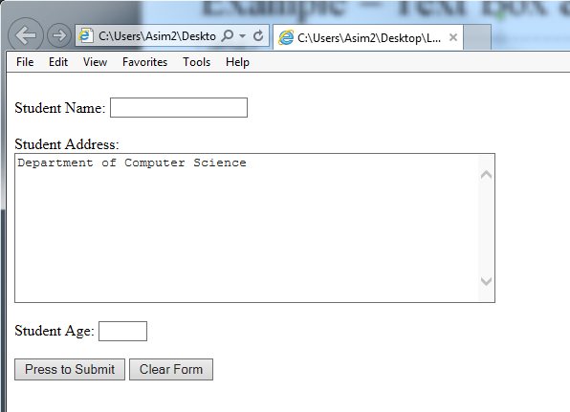
Text Area
To enter more text in multiple lines, we use Text Area
  <TEXTAREA NAME=“address" ROWS="10" COLS="60">
  default text
  </TEXTAREA>
<form>
Student Name:
<input type=text Name="sname" >
<BR><BR>
Student Address:<BR>
<TEXTAREA NAME=“address" ROWS="10" COLS="60">Department of Computer Science
</TEXTAREA>
<BR><BR>
Student Age:
<input type=text Name="age" size="4" maxlength="2">
<BR><BR>
<input type="submit" value="Press to Submit">
<input type="Reset" value="Clear Form">
</form>

Slide 5
Password field: type=“password”
Password field is text field where the entered characters of a password are masked (shown as asterisks or circles)
<input type="password" name="psw">

Slide 6
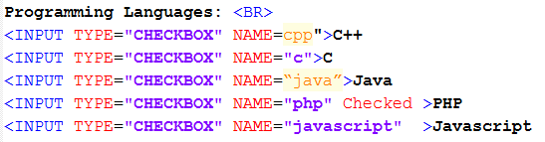
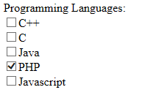
Checkboxes
Checkboxes are used to allow users to select ZERO or MORE options of a limited number of choices.

Slide 7
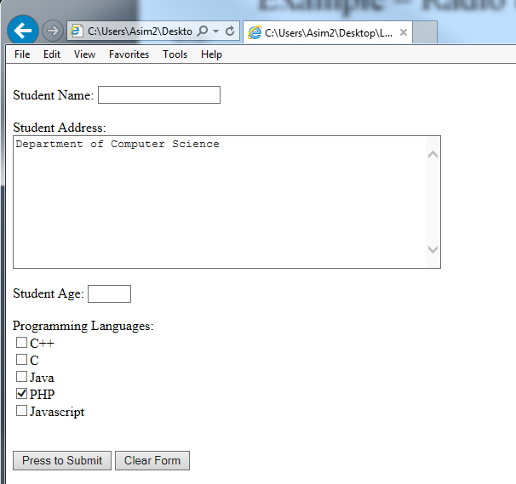
Example

Slide 8
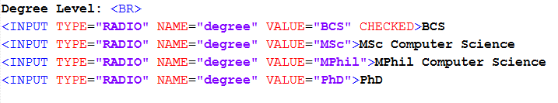
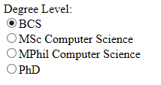
Radio button
<input type="radio"> defines a radio button.
Radio buttons let a user select ONLY ONE of a limited number of choices.

Slide 9
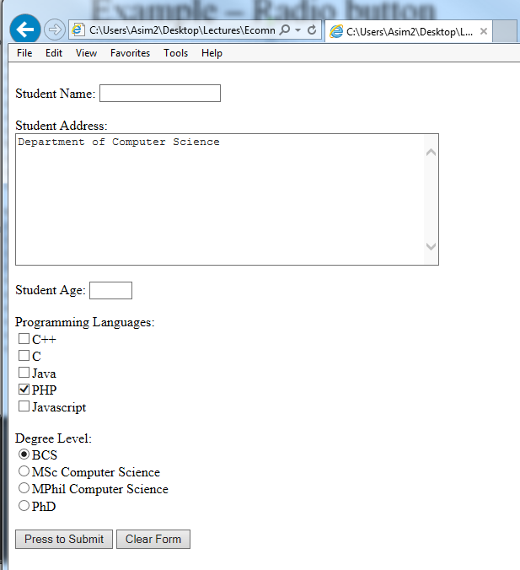
Example

Slide 10
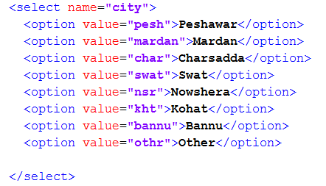
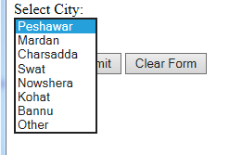
The <select> Element (Drop-Down List)
The <select> element defines a drop-down list:
  The <option> elements defines the options to select.
  The list will normally show the first item as selected.
  You can add a selected attribute to define a predefined option.

Slide 11
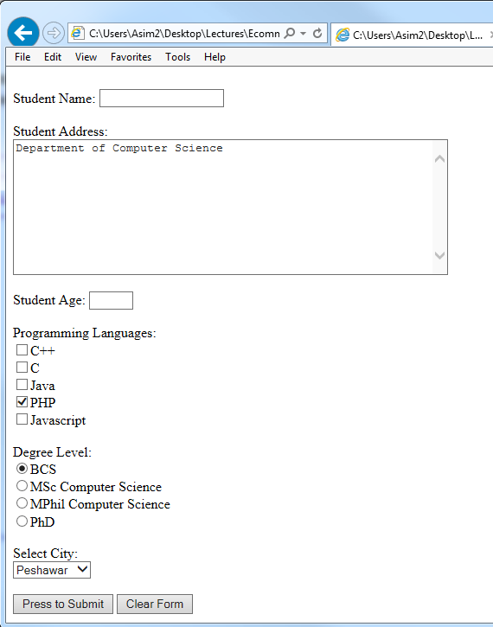
Example

Slide 12
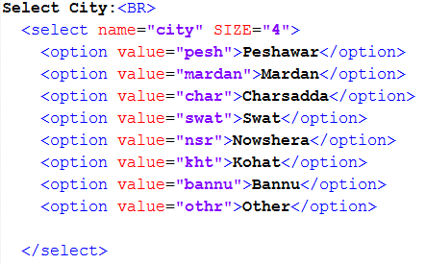
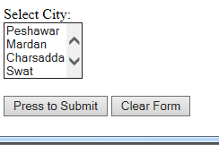
Example
Changing number of visible options in the list
  <select name="city" SIZE="4“ >

Slide 13
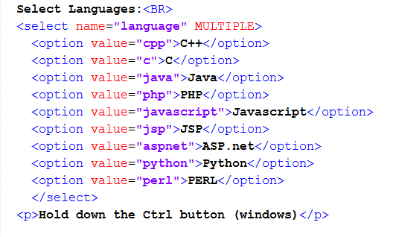
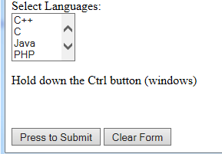
Multiple selection
  <select name="language" MULTIPLE>

Slide 14
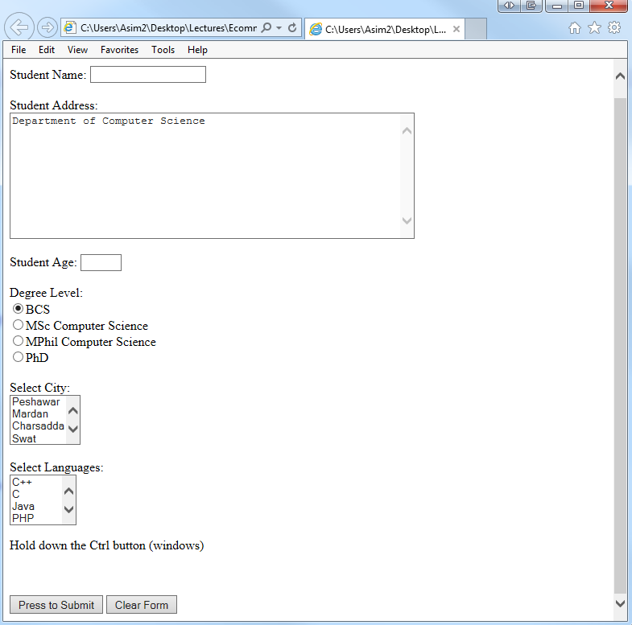
Example

Slide 15
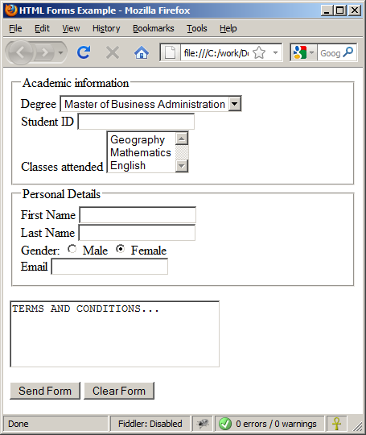
Fieldset
It groups related elements in a form:
  e.g:
  Personal data fields
  Academic data fields

Slide 16
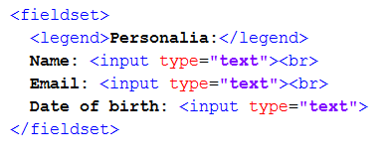
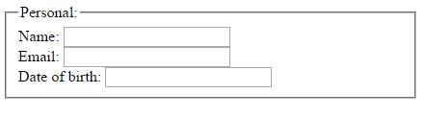
Example

Slide 17
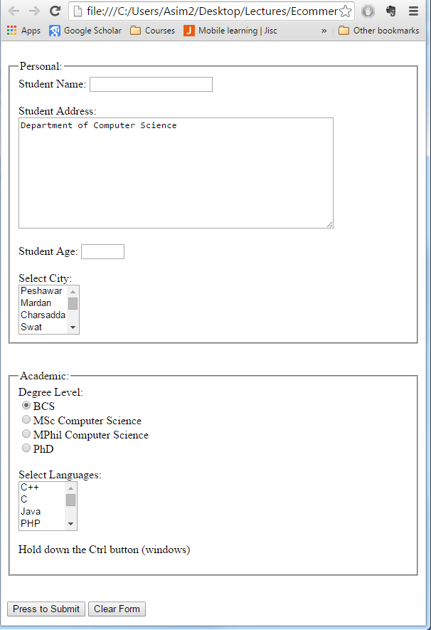
Example

